Slide 1
Operational Audit of the Crime Prevention Department Office February 24, 2026
Presented by: Donna L. McGinnis, CPA, CFE Internal Auditor/Compliance Officer, Jonathan Smith, Benjamin Meadow & Grant Conaway, Forensic Auditors

Slide 2
Audit Authorization
The audit was authorized by City Council on September 16, 2025.

Slide 3
Audit Process
Authorization of Audit
Development of Audit Program
Entrance Conference With Auditee
Conduct of Fieldwork

Slide 4
Audit Process (Continued)
Preparation of Draft Audit Report
Exit Conference with Auditee
Auditee Response
Preparation of Final Audit Report
Presentation to City Council

Slide 5
Audit Scope
Budget Review.
Review of website presentations and linked application records.
Program field visits, observing impact.
Review of IRS 990 filings , confirming program compliance.

Slide 6
Audit Findings
Program awards are distributed monthly, managing liability.
Program funding is provided to both institutional non-profit organizations as well as smaller “grassroots".
The Crime Prevention Director is active in the community, organizing neighborhood meetings, partnerships and response teams as needed.

Slide 7
Audit Findings , continued
Program awards are managed annually, providing smaller awards in successive years to allow for funding for new ‘grassroots” programming.
The Crime Prevention website has developed over time, and currently includes YouTube presentations from recipient organizations as well as a link to recent application materials.
The Crime Prevention Director and the Crime Prevention Board members encounter a great deal of community pressure and scrutiny re: award decisions that are made annually.

Slide 8
Audit Findings , continued
Program funding supports several silos of community care: at-risk youth activities, prison to workforce programming, assistance for families in need and recovery support for domestic violence victims.
The Crime Prevention Director also provides assistance and tutoring to young “grass roots” organizations, seeking to position them for success in the Board review & approval process.
The Crime Prevention has not previously successfully developed access to crime or impact statistics Such access can involve hurdles re: the disclosure of relevant data.

Slide 9
Audit Recommendations
Recommend re-design of the department’s website with a focus on the community silos of care, with recent recipients identified by silo.You Tube material and application records should still be displayed.
Recommend collaboration between Crime Prevention and the Columbus Police Department re: the development and distribution of a quarterly Flash Impact Statistical Report, with an initial release on June 30, 2026.
Recommend revising program criteria, providing one level of potential annual funding for developed institutional programs, with a lower tier of proposed annual funding for young “grass roots” organizations.
Recommend the addition of an Administrative Assistant for Crime Prevention as the program has seen a 400% increase in program funding, and a 600% increase in applicants in recent years.

Slide 10
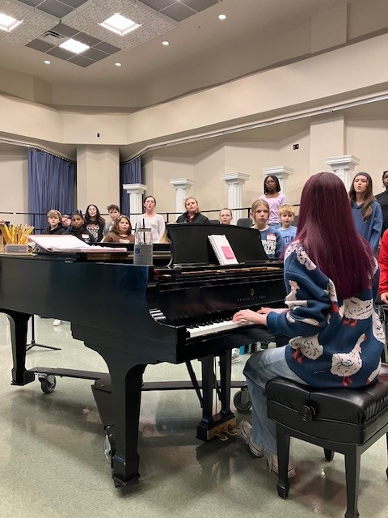
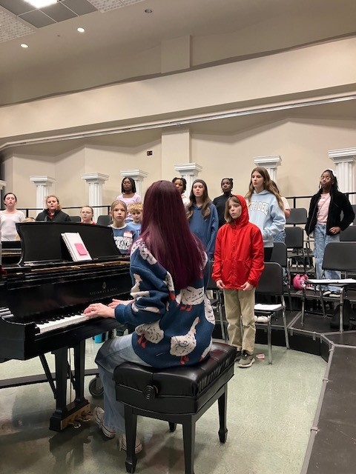
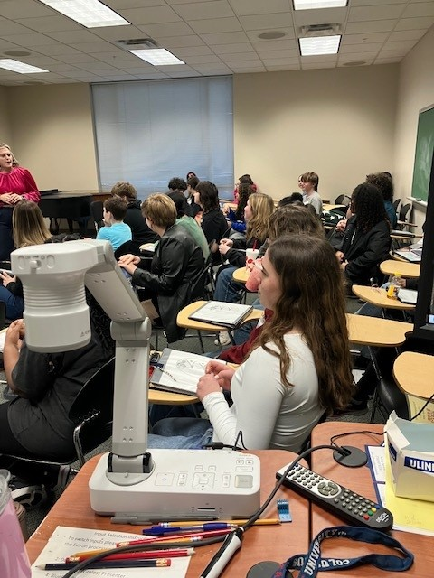
Voices of the Valley Visit

Slide 11
Questions
Are there any questions from City Council or Executive Management regarding this report?

